Slide 1
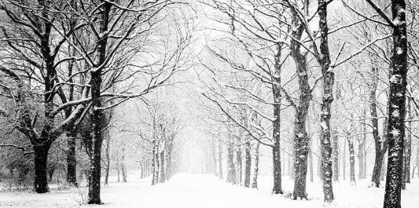
Weather Image Classification

Slide 2
Background
Dataset: https://www.kaggle.com/datasets/jehanbhathena/weather-dataset/data
This dataset contains 6862 images that can be classified into 11 classes of weathers
The dataset is splitted to 80% for train and 20% for validation
Each classes are uneven, ranging from 300 images – 600 images per class

Slide 3
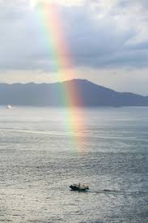
Objectives
Train existing model (ResNet18 and ResNet50) with the weather images
Deploy trained model on Gradio for evaluation
The deployed model should be able to classify between different classes of weathers

Slide 4
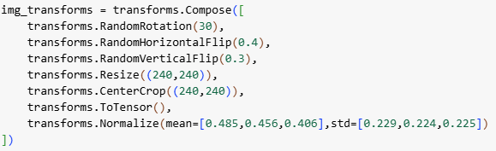
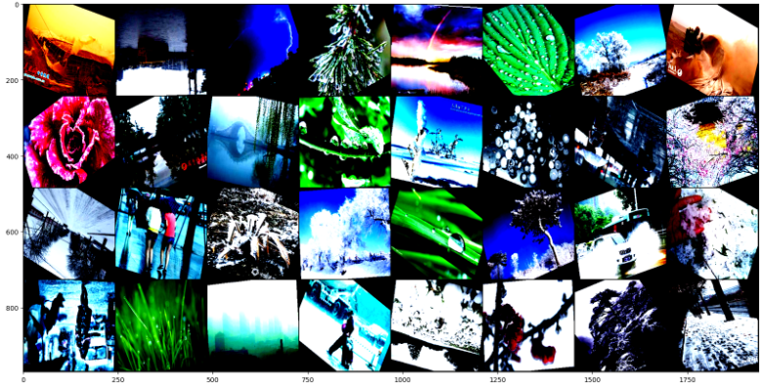
Data Augmentation

Slide 5

Loss function and optimizer

Slide 6


Freezing and Unfreezing

Slide 7
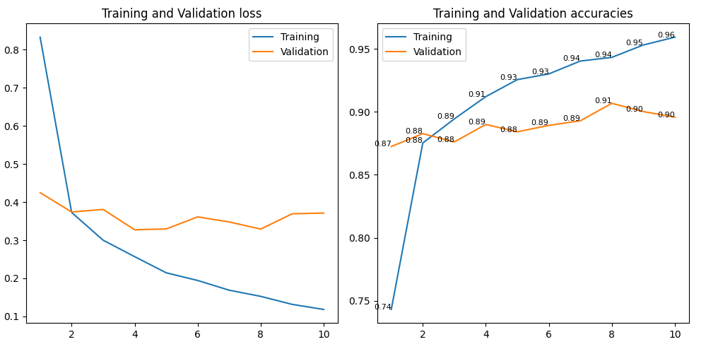

Using ResNet18 with lr=1e-4

Slide 8
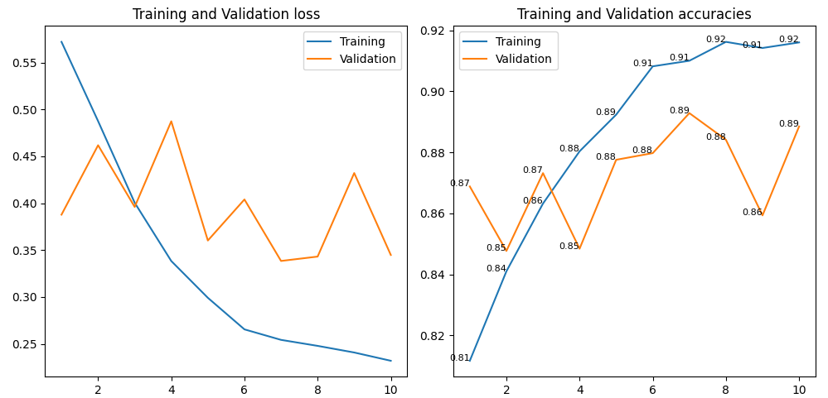

Using ResNet18 with lr=0.001

Slide 9
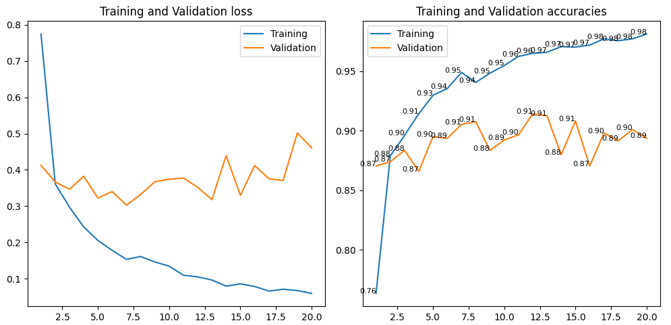
Using ResNet18 with 20 epochs

Slide 10
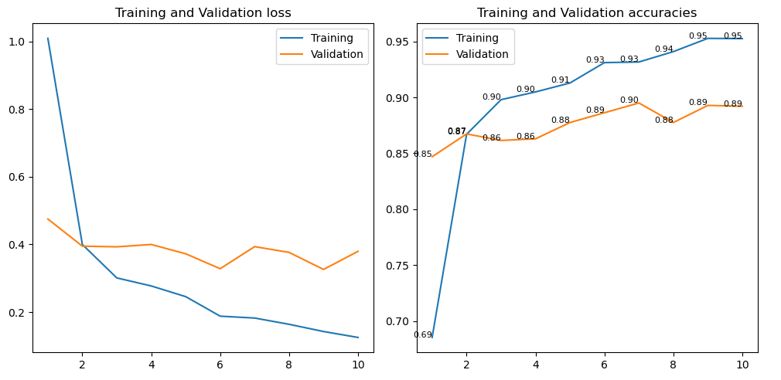

Using ResNet18 with Dropout

Slide 11
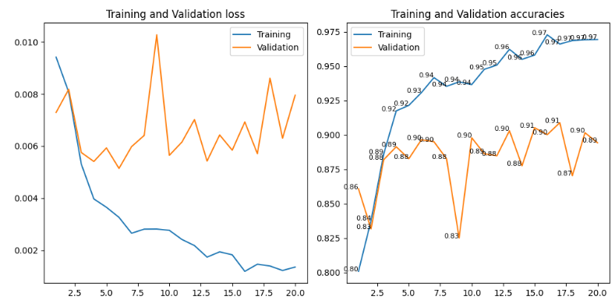

Using ResNet50

Slide 12
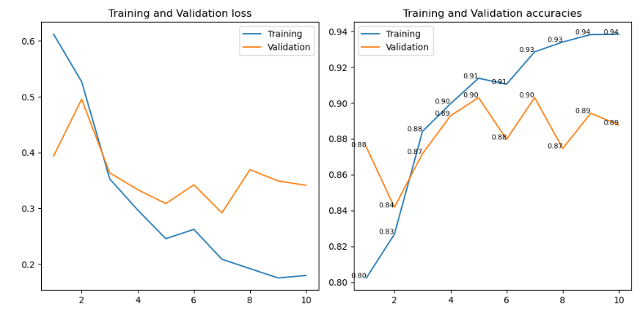

Using ResNet50 with Dropout, lr=1e-4

Slide 13
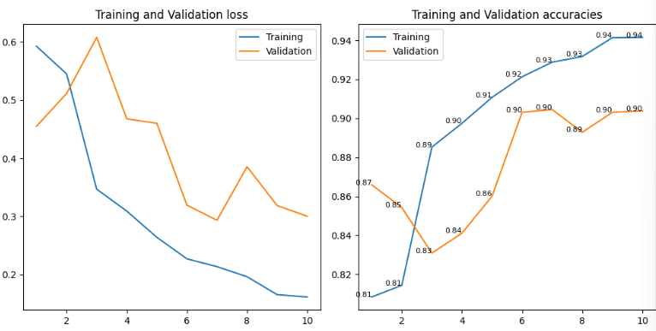
Using ResNet50 with Dropout, lr=0.001

Slide 14
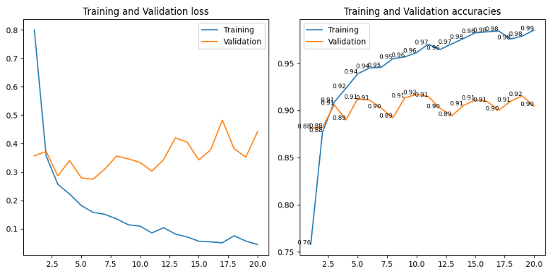
Using ResNet50 with Dropout, 20 epochs, lr=1e-4

Slide 15
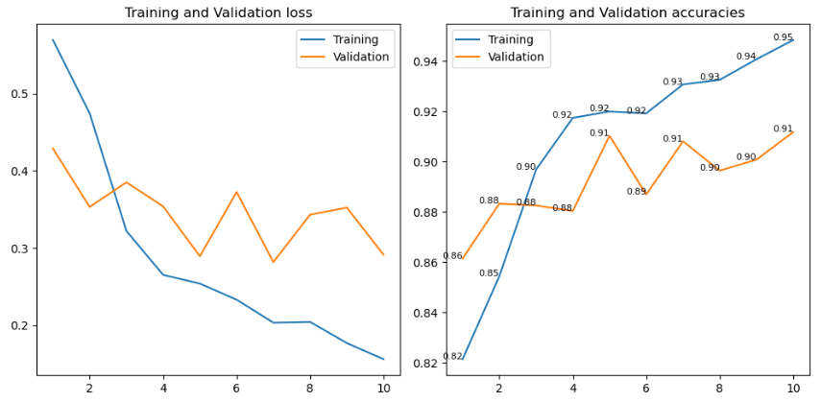
Using ResNet50 with different data augmentation

Slide 16
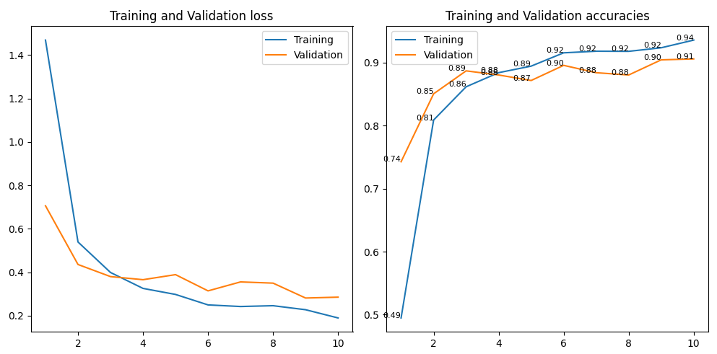
Using ResNet50 with 10 epochs

Slide 17
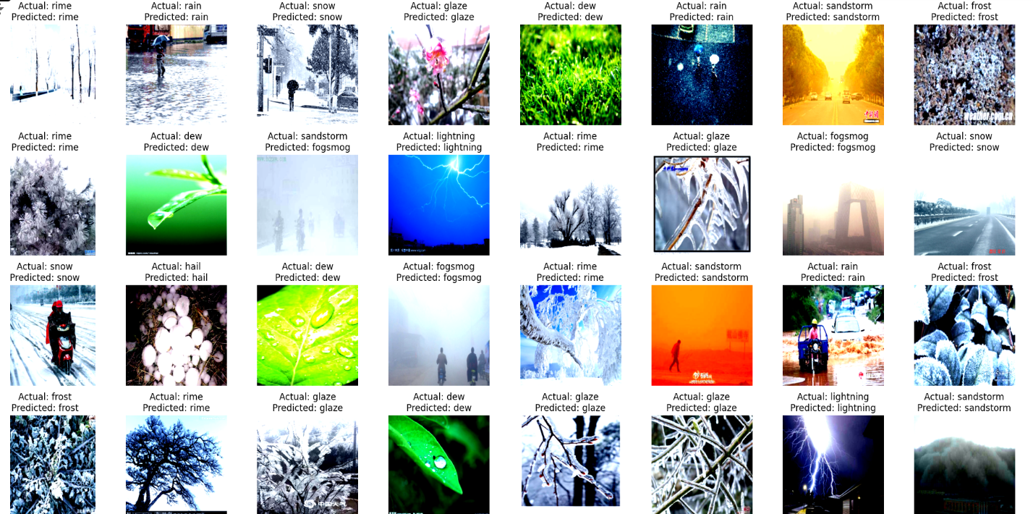
Results

Slide 18
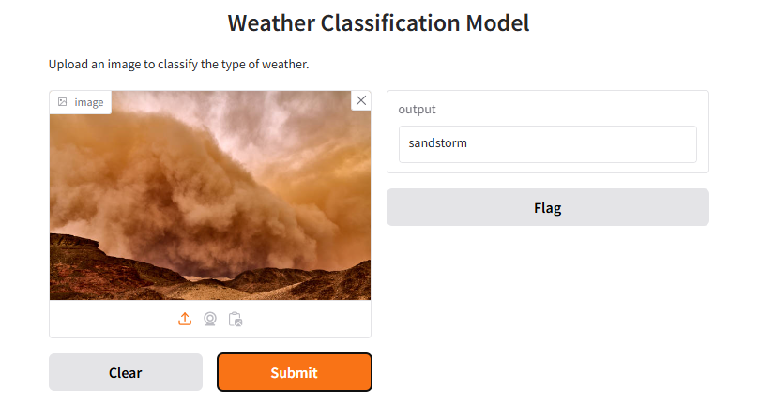
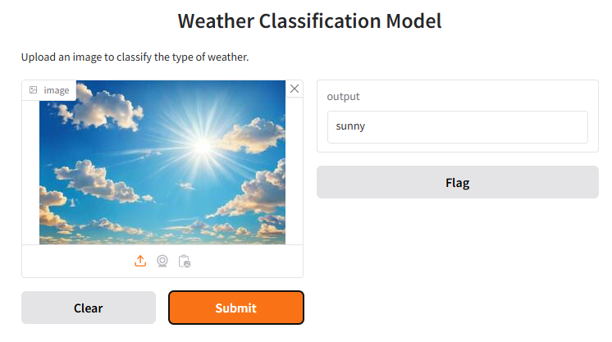
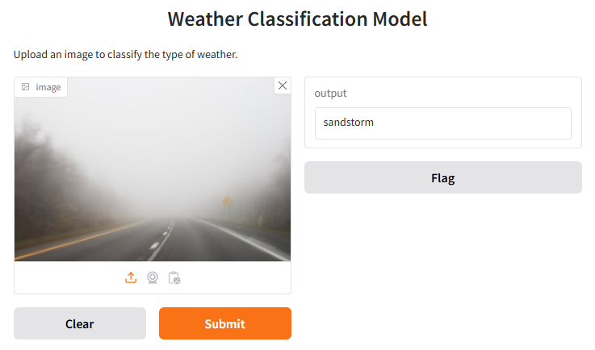

Results

Slide 19
Thank you

Slide 20
When num_worker = 4

